Slide 1

OpenCafe Architecture and Implementation
Daryl Walleck
Senior Software Developer in Test
OpenCafe Maintainer

Slide 2
Overview
Project Objectives
Project Design
Acquisition and Installation
Client Design and Implementation
Plugins

Slide 3
Why Create OpenCafe?
Provide a means to create code-driven API tests
Create an efficient parallel test runner to minimize test execution time for long running tests
Provide detailed output so it is clear what actions occurred during the execution of a given test
Tests should be executable against an arbitrary number of test environments
Develop a “batteries included” testing solution
Notes:
ease of understanding and to allow for easier triage

Slide 4
Core OpenCafe Projects
Open Source
OpenCafe – Test runner, configuration and logging management, plugins (HTTP, SSH), base unittest fixtures
CloudCafe – Client and configuration definitions for OpenStack projects
CloudRoast – End-to-End tests for OpenStack projects
Internal
RaxRoast – End-to-End tests designed specifically for Rackspace’s OpenStack public cloud

Slide 5
OpenCafe Project Hierarchy
OpenCafe
CloudCafe
CloudRoast
RaxCafe
RaxRoast

Slide 6
OpenCafe Architecture
Python
Test Runners
unittest
pytest
App Drivers
Requests
(HTTP)
Paramiko (SSH)
pywinrm
(WinRM)
behave
Config Manager
Files
Env Variables
HTTPClient
LinuxClient
WindowsClient
AutoMarshalling HTTPClient
Remote Instance Validation Client
Notes:
We created three abstractions: test runners, application drivers, and configuration management.
You can have any runner you want as you write a plugin for it.
You can use requests and have it auto-serialize your responses.
You can validate specific data about a virtual machine without knowing the underlying OS.
You can use configuration files and environment variables to configure your tests

Slide 7

Demo - OpenCafe Installation and Initialization
This demo can also be seen at https://asciinema.org/a/169415?speed=2
Notes:
Add picture link
Discuss process
Show .opencafe file structure
Show engine.config

Slide 8
OpenCafe COncepts

Slide 9
OpenCafe Terminology
Client
A class whose functions are a one-to-one mapping of possible API requests
Model
An object representation of a JSON or XML request or response
Entity
A model that has been attached to an API response
Behavior
A method that encapsulates a logical series of API requests
Composite
A class that represents all aspects of a given API including its client, models, configuration, and behaviors

Slide 10
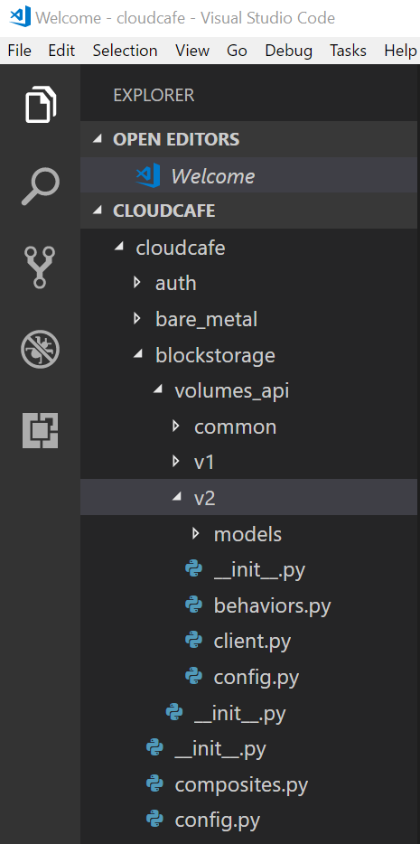
CloudCafe Project Package Structure
One package per product
One sub-package for each API endpoint
For each endpoint:
Model definitions
API client Class
Behaviors class (Optional)
Configuration class (Optional)
Composite class

Slide 11
Clients
Client
request_entity
Request JSON
Response.JSON
response.response_entity_type
Response.Entity

Slide 12
Model Serialization Flow
Request Object
_obj_to_json
Raw JSON
Client response
_json_to_obj
Response Object

Slide 13
Behaviors
Example:
Make a create server request
Poll the server’s status
Exit when server status is “active”
Notes:
Clients do not have sensible defaults. A behaviors are functions that encapsulate a project’s common workflows so other projects can use those functions without needing to fully understand how

Slide 14
Configuration Classes
Convention of one project configuration and optionally one per API endpoint
SECTION_NAME property that maps to the config section in the file
functions whose names map to entries within the SECTION_NAME of the config file
Return types can be cast to other types than string
Notes:
The project level configuration is meant to contain items necessary for any use of the project. The per API configurations are usually relevant to only that functionality

Slide 15
Plugins

Slide 16
Plugins - HTTP
Based on the Requests library
Adds logging and serialization of requests and responses
Allows for direct passthrough to requests using requestslibkawrgs

Slide 17
Plugins - SSH and WinRM
Encapsulated by RemoteClient class
Perform a subset of commands on Linux or Windows hosts and return uniform responses
Used to validate properties of virtual machines

Slide 18
Questions?

Slide 19
Links
Projects
OpenCafe – https://github.com/cafehub/opencafe
CloudCafe – https://github.com/openstack/cloudcafe
CloudRoast – https://github.com/openstack/cloudroast
Documentation
Main documentation – https://opencafe.readthedocs.io
Quickstart - http://opencafe.readthedocs.io/en/latest/quickstart/index.html
Slides and Materials
https://github.com/dwalleck/opencafe-training

